Slide 1
SENTIMENTAL ANALYSIS OF TWITTER DATA
CPSC 531-01 (13548)
Presented By:
ROHIT SAHA (893572115)
Parijat Das (898161435)
Guided By:
Dr. Chun-l Phillip Chen

Slide 2
AGENDA
Introduction
Project Objective
What is Sentimental Analysis
System Design Methodologies
System Architecture
Project Specification(A Brief discussion on the algorithms used and the dataset)
Project Walk through
Algorithm comparison
Model evaluation
Representation of the result
Demo
Significance
What We Learned
Conclusion and Implication

Slide 3
INTRODUCTION
Twitter is a popular microblogging website.
Each tweet has almost 140 characters in length.
Tweets are frequently used to express tweeter’s emotion on a particular object.
There are organizations which hire twitter for analyzing sentiments on a particular subject. This sentimental analysis helps determining future strategies.

Slide 4

OBJECTIVE OF THE PROJECT
To implement an algorithm for classifying tweets into positive, negative or neutral
Using Sentimental analysis to determine the attitude of the mass, whether positive, negative, or neutral towards a specific topic.
Representing the analysis result graphically for its better understanding and correct decision making.

Slide 5




SENTIMENTAL ANALYSIS…..??
Sentiment analysis (also known as opinion mining or emotion AI) refers to the use of natural language processing, text analysis, computational linguistics, and biometrics to systematically identify, extract, quantify, and study affective states and subjective information. The process of computationally identifying and categorizing opinions expressed in a piece of text, especially in order to determine whether the writer's attitude towards a particular topic, product, etc. is positive, negative, or neutral.
negative
positive
neutral

Slide 6
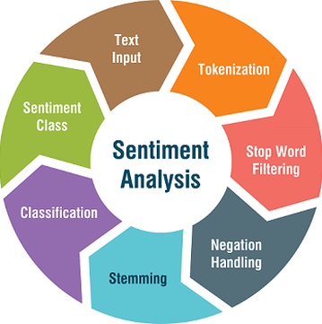
SYSTEM DESIGN METHODOLOGIES

Slide 7
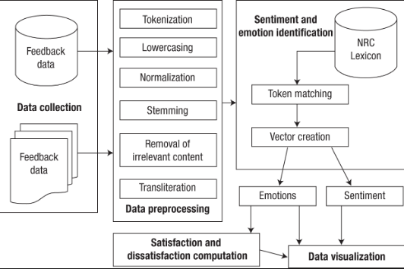
SYSTEM ARCHITECTURE

Slide 8
PROJECT SPECIFICATIONS
Hardware Specifications: | Software Specifications: | Programming Languages
Processor: 64-bit, core i5 RAM: 8 GB Operating System: Windows 10 Hard Disk: 160 GB | Python 3.7.3 Flask Framework Python Libraries Tweeter API - Tweepy Jupyter Notebook Visual studio | Python JavaScript HTML CSS

Slide 9
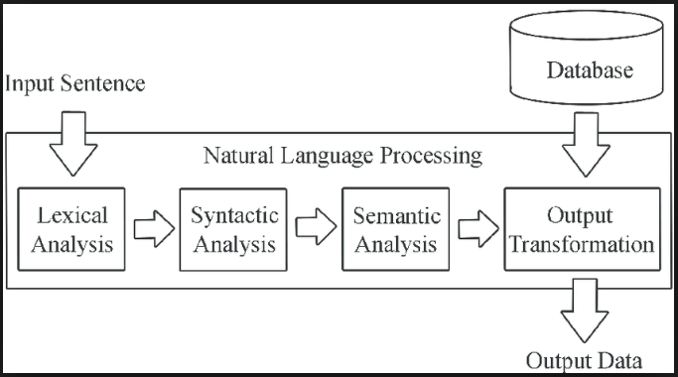
NATURAL LANGUAGE PROCESSING
NLP deals with analyzing, understanding and generating the languages that humans use naturally in order to interface with computers in both written and spoken contexts using natural human languages instead of computer languages.

Slide 10
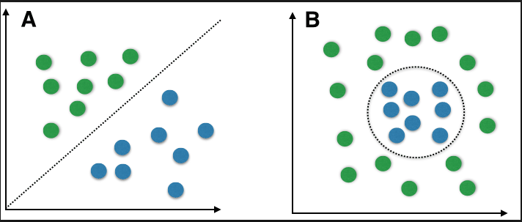
NAÏVE BAYES
Naive Bayes is a machine learning algorithm for classification problems. It is based on Bayes' probability theorem. In Naïve Bayes classifier the class of the text is determined using the theory of probability (positive, neutral or negative).

Slide 11
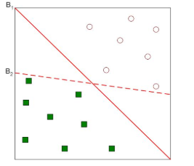
SUPPORT VECTOR MACHINES
In this algorithm, we plot each data item as a point in n-dimensional space (where n is a number of features you have) with the value of each feature being the value of a particular coordinate. Then, we perform classification by finding the hyperplane that differences the two classes very well.

Slide 12
DATASET:
Training Data Set | Test Data Set
Training Data Set has been downloaded from Kaggle. It consists of three individual files: ProcessedPositive.csv(tweet text of all positive tweets) ProcessedNegative.csv(tweet text of all negative tweets) ProcessedNeutral.csv(tweet test of all neutral tweets) Total 10000 tweets have been used to train the model | Twitter API has been used to extract tweets on a real time based on the topic specified by the user. Total 200 tweets have been used for test data. *NOTE: only 200 tweets per 15 mins can be accessed from the API. We could access the API every 15 mins and extract data as per specified by user and build a large testing set

Slide 13
PROJECT WALK-THROUGH
Section A: Preparing The Test Set
Twitter API has been used to extract tweets based on the topic specified by the user. The test set contains the tweet_id and tweet text for 200 tweets specific to the user defined topic. The data is loaded as json data.
Section B: Preparing The Training Set
The training data set is a collection of 10000 tweets containing tweet_id, tweet text and tweet sentiment. The data from the training data set is loaded into a json object for processing
Section C: Pre-processing Tweets in The Data Sets
The training and the test data set, both require Pre-processing. This is the most important data mining technique that involves transforming raw data into an understandable format. Real-world data is often incomplete, inconsistent, and/or lacking in certain behaviors or trends, and is likely to contain many errors. Data preprocessing is a proven method of resolving such issues.

Slide 14
PROJECT WALK-THROUGH CONTD..
Section D: Training the classifier
Vocabulary is built from the training dataset and tweets are matched against them to develop the feature vector. This technique is used to train the classifier.
Section E: Testing The Model
We have used NAÏVE BAYES, SUPPORT VECTOR MACHINES AND NATURAL LANGUAGE PROCESSING to perform sentimental analysis on the test data, calculate and compare the accuracy of the result

Slide 15
THREE ALGORITHM COMPARISON
Algorithms | Advantages | Disadvantages | Time Complexity
Support Vector Machine (SVM) | SVM provides notably fast classifiers. Is more suitable for cases where the number of instances is lower than the number of features | high algorithmic complexity and extensive memory requirements of the required quadratic programming in large-scale tasks. | O(n2 ) n=Number of Instances
Naïve Bayes (NB) | NB is easy to understand, a simple and quick technique of sentiment analysis. It normally requires a minimal data set for training | NB Classifier makes a very strong assumption on the shape of your data distribution, i.e. any two features are independent given the output class. Due to this, the result can be (potentially) very bad - hence, a “naive” classifier. | O(nm) n=Number of Instances m=Number of features
Natural Language Processing | Relieves burden of learning syntax No training required | Requires clarification of syntax May require more keystrokes May not show context Is unpredictable | O(n) n= Number of Tweets

Slide 16
MODEL EVALUATION
Algorithm | NAÏVE BAYES | SVM | NLP
Runtime (Sec) | 53.49 | 56.93 | 54.23
Standard Deviation | 0.1874 | 1.4859 | 2.6737
Accuracy | 80 | 87 | 73

Slide 17
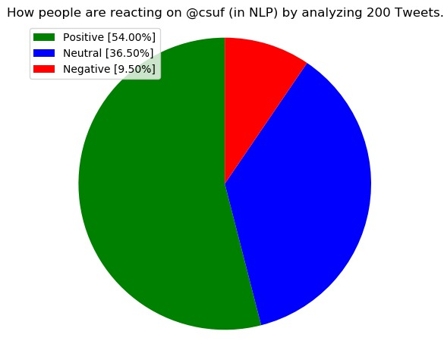
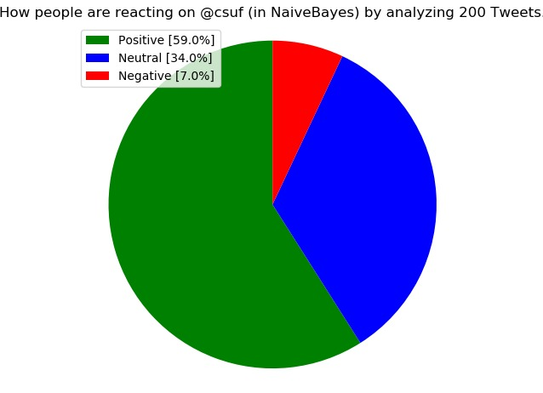
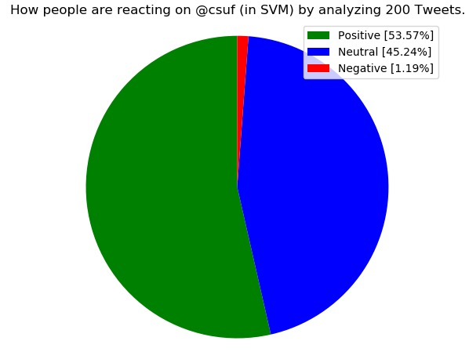
GRAPHICAL REPRESENTATION OF THE RESULT
NLP(Natural Language Processing) | Naïve Bayes | SVM(Support Vector Machines

Slide 18
Demo

Slide 19
SIGNIFICANCE
Application allows user to perform sentimental analysis on any topic/ person to get review on the same
This System can be used by many organizations to decide business strategies and get product reviews.
Based on the analysis appropriate action can be taken going forward.

Slide 20
What We Learned
Flask Framework is the easiest way to integrate HTML based web application with Python based backend.
Python programming language is used for its ease of understanding and robustness.
Sentimental Analysis can be done based on various attributes such as the topic and the number of data you want to analyze.
Jupyter helps us to understand the effectiveness of analyzed data.
Jupyter Notebook is the most effective open source tool for visualization of data using Graphs and charts.
Understood significance of multiple Python libraries like NumPy and Scikit-Learn.

Slide 21
Conclusion and Implication
Python is used for its ease of understanding and robustness
The objective of our project is to get latest review for any item on the basis of tweets posted on the same
The analysis plays very important role in reviewing a product and developing future improvements based on user reviews

Slide 22
Thank You!

